Slide 1
New Release Notification
We are pleased to announce an upcoming Cytric version release from November 2019.
New Cytric user interface for the full Air and Rail workflow will be included in the Cytric release 18.1 on November 17, 2019.
Please see presentation below introducing the most important changes in the new Air and Rail flow and all the details on these major changes. It will help the users get more familiar with the new user interface and help them to learn how to maximize their use of Cytric.

Slide 2
What’s new in the Air and Rail booking flow in more details Amadeus cytric Travel & Expense Release 18.1

Slide 3
Who is this presentation for ?
This presentation has been prepared for you to give greater insight on the major changes coming with the new user interface in the air and rail workflow.
It will help you, as an end-user, get more familiar with the new user interface.
It will provide you, as an administrator, with information on how to review existing set-ups and maximize your use of cytric.

Slide 4
What’s in it for you?
Book whenever and wherever it suits you Use the device of your choice (mobile, tablet, laptop, desktop)
Save time More user-friendly interface Same look and feel throughout (booking travel, expenses and mobile) Compact display (collapsed to expanded view for more details)
Get the best value for money Greater visibility and filtering options
Ability to compare flights and fares easily
No hidden fees: clear breakdown of fare provided

Slide 5
Availability page
Notes:
Divider example with photo
Insert new photo: Click on Insert photo-icon on slide and Insert new photo
Use Crop Tool under Picture Tools to pan and zoom
To update the text, just click on the text
To get more slides with this layout just copy this slide and paste

Slide 6
Major changes in the Availability page
Flexibility on how to choose your flights: layout has been designed to display the results of both sort by fare and sort by schedule, on a single page!
New sorting and filtering features with additional criteria to help you make better decisions
Separate tab for outbound and for inbound instead of scrolling. For each outbound you will be given a certain number of inbound flights.
Visual indicator to bring attention to important flight details (e.g. arrival next day, change of airport)
Focus on lowest fare: you will see the lowest total trip price regardless of the sorting order

Slide 7
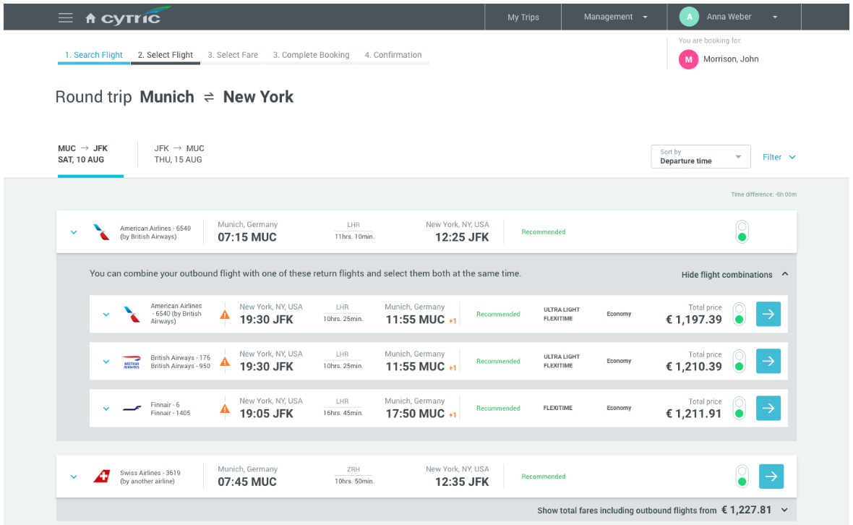
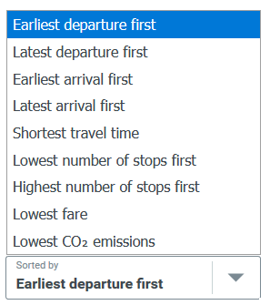
Availability page
Same look and feel regardless of sorting criteria
One layout, one policy
This layout has been designed to display the results of both sort by fare and sort by schedule, on a single page
User-friendly The recommended options are now clearly labeled
Sort & Filter
You can make better decisions by sorting and filtering using multiple criteria. For example sort by fare with ‘Lowest fare’ option or sort by schedule with ‘Earliest departure’ option
Easy to progress
Continue button for each flight option.
You no longer need to scroll down

Slide 8
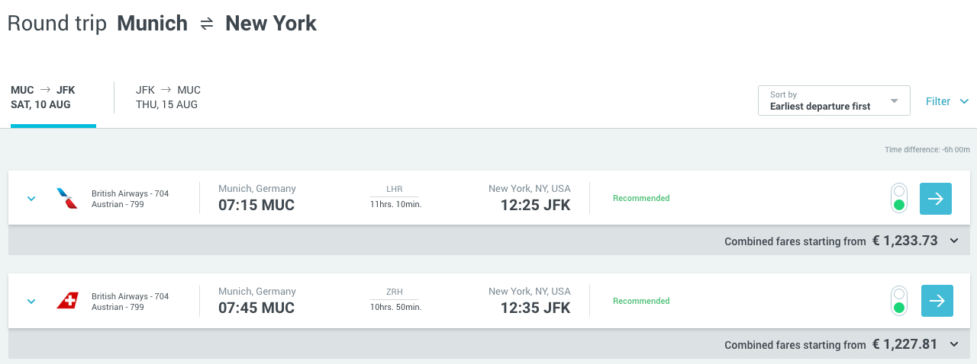
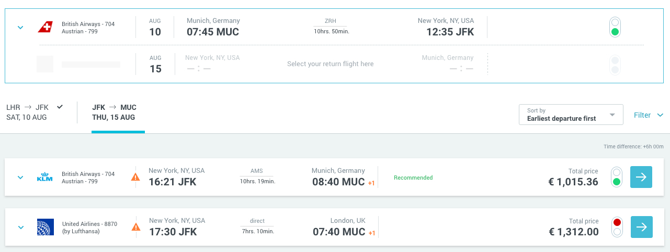
Availability page
First way of booking your flight
1
A two-step approach:
1 - Select your preferred departure flight
2 - Then you will be automatically taken to the inbound tab to choose your return flight
2
Note: You can do it the other way round. Select your return flight first and view all departure flights available
Notes:
To update the text, just click on the text
More slides with this layout: Copy slide and paste

Slide 9
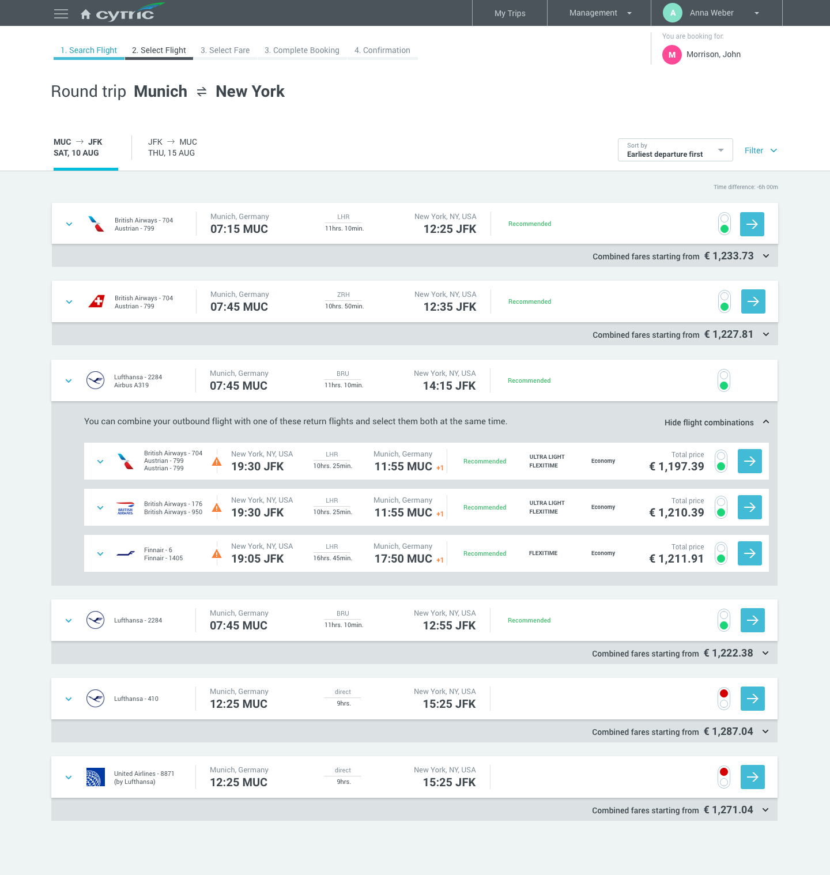
Availability page
Second way of booking your flight
A one-step approach
Save time and combine the 2 steps: expand the collapsed section and select both departure and return flights in one click!
The price covers the whole trip
Notes:
To update the text, just click on the text
More slides with this layout: Copy slide and paste

Slide 10
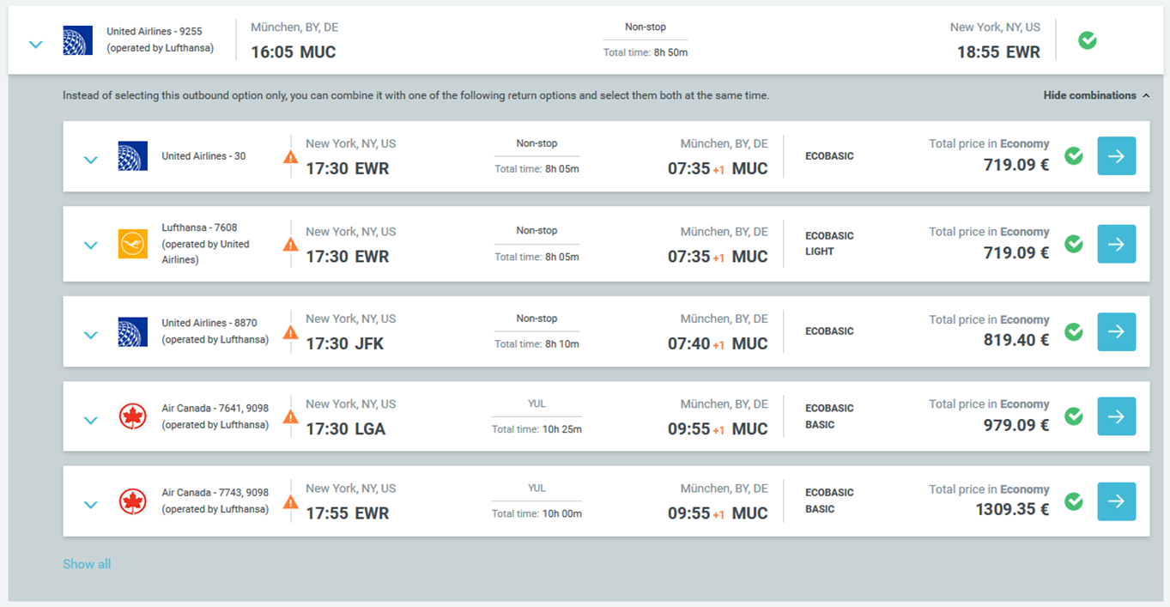
Availability page
An intuitive user experience with all the relevant content at your fingertips
Improved display of various flight combinations
For each departure flight you can easily view all the possible return options
Focus on the lowest fare
Up to 5 return flights that can be combined with the departure flight, sorted by fare
More return options
Click on ‘Show all’ to see all available return flights. You will then be redirected to the return tab
Notifications
Orange icons to attract your attention
Notes:
To update the text, just click on the text
More slides with this layout: Copy slide and paste

Slide 11
Availability page
Every detail clearly laid out to make it easier for you to compare
Clear structure
The key information is presented in the collapsed view
More information
Expand it to get more information on any departure or return flight
Policy indicator
Red and green policy indicators in the expanded view show if the class is within policy
Travel time information
As before you can still see the total travel time and the duration of each flight. Now you can see the connection time too!
Notifications
An orange text is displayed to attract your attention to certain details
Notes:
To update the text, just click on the text
More slides with this layout: Copy slide and paste

Slide 12
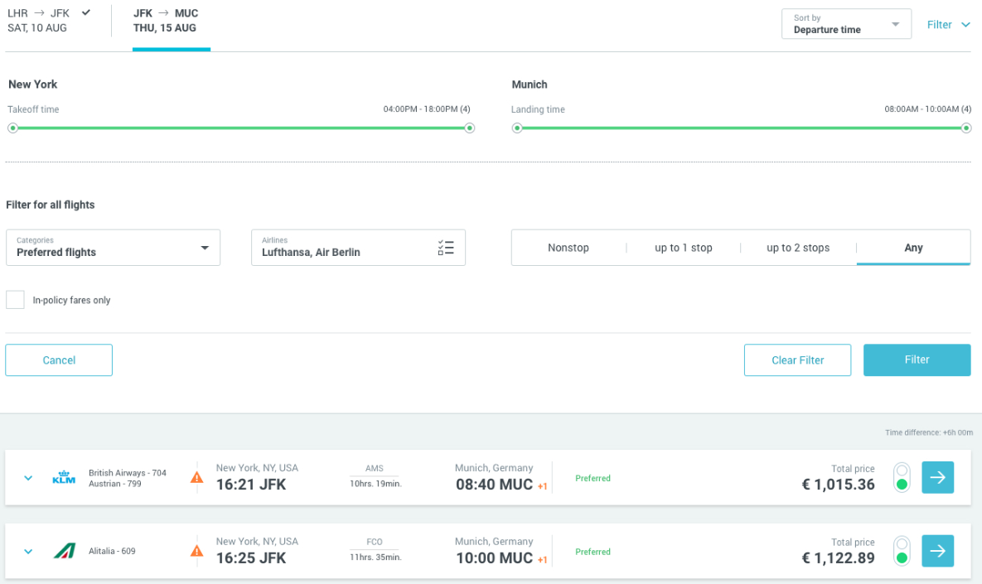
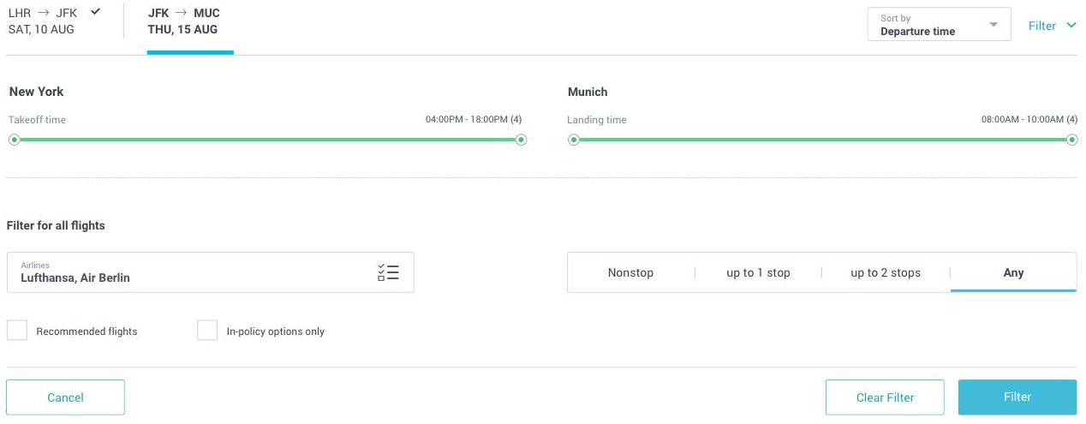
Availability page
Extra criteria that you can sort and filter however you like
Dynamic filter
Filter options will adapt depending on available flights
Time range for departure and return flights
Drag green bar to select the time range you want
Filter by airlines
Use the dropdown menu to filter by available airlines
Clear layout
Click on radio buttons to filter out flights out-of-policy or not recommended
Notes:
To update the text, just click on the text
More slides with this layout: Copy slide and paste

Slide 13
Fare selection page
Notes:
Divider example with photo
Insert new photo: Click on Insert photo-icon on slide and Insert new photo
Use Crop Tool under Picture Tools to pan and zoom
To update the text, just click on the text
To get more slides with this layout just copy this slide and paste

Slide 14
Major changes on the Fare selection page
Ability to check more fares of different classes for the same flight to get the best value for money
You can now filter fares by class, services and cancellation conditions to help you make smarter decisions
Clear differentiation between round trip tickets and one way tickets: total price for the whole trip is displayed for two one way tickets too!

Slide 15
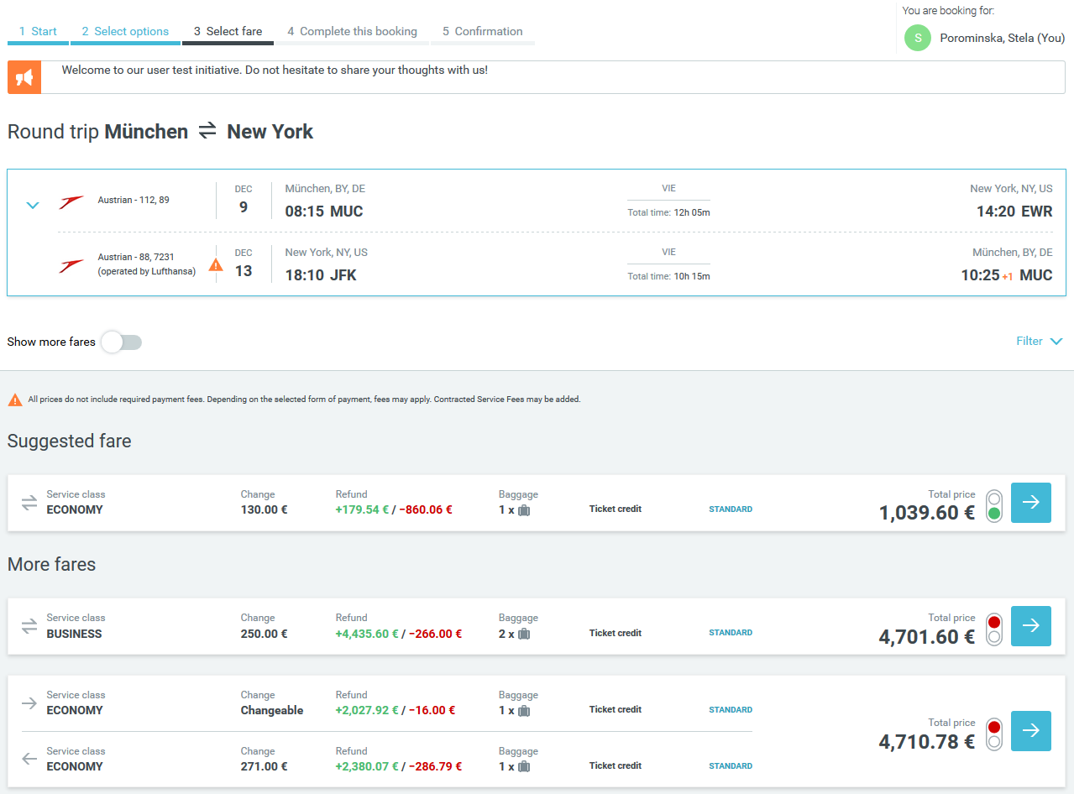
Fare selection page
Same look and feel throughout the flow
Cumulative display
As you advance through each stage of your booking, all new information will be reflected on your trip summary
Filter options
Introduction of an entirely new filtering system (see next page)
Better visibility
Pre-selected fare is now presented first and labeled “Suggested fare”
Notes:
To update the text, just click on the text
More slides with this layout: Copy slide and paste

Slide 16
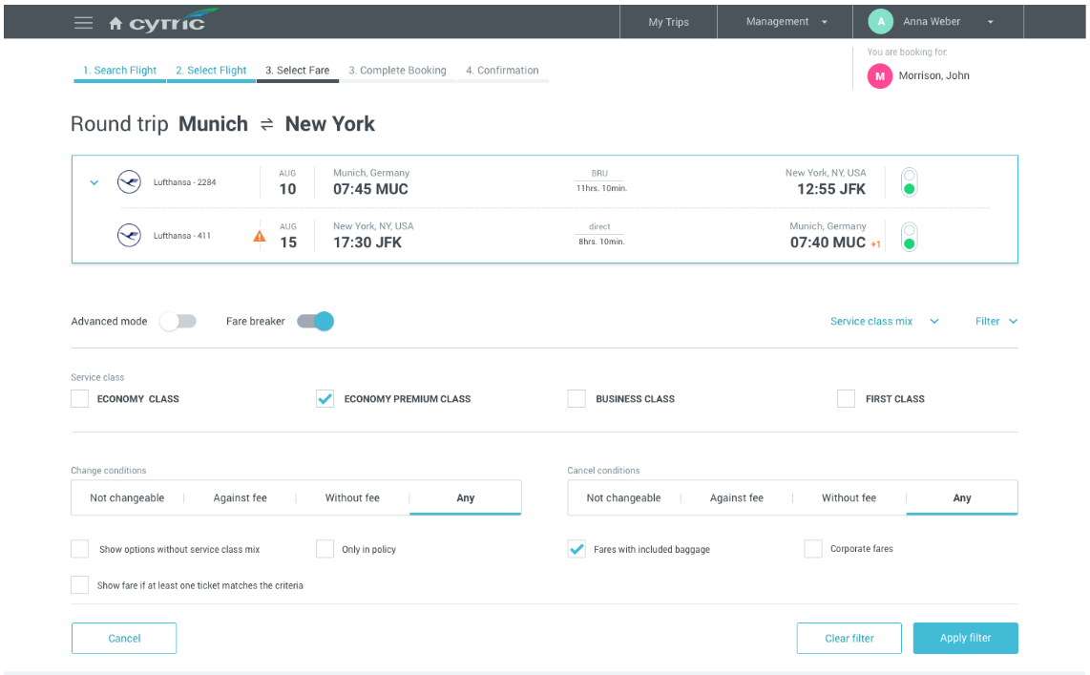
Fare selection page
Filter fares by class, services and cancellation conditions
Dynamic filter
Filter options will adapt depending on available fares
Cancellation conditions
You can filter by rebooking and cancellation conditions
More filter options
You can filter by policy, baggage, corporate fares, etc.
Notes:
To update the text, just click on the text
More slides with this layout: Copy slide and paste

Slide 17
Fare selection page
Advanced features
Clear guidance
Control buttons are very visible
Customized view
Switch from simplified to customized view to get more alternative fares
Fare breaker
Cost conscious customers can simply activate the dynamic fare breaker
Service class mix
Expandable section to enable a mix of classes if wished
Notes:
To update the text, just click on the text
More slides with this layout: Copy slide and paste

Slide 18
Fare selection page
Get the best value for money
Type of fare stands out
Clear differentiation between round trip tickets and one way tickets
A single price
Total price of the trip is displayed for two one way tickets too!
Fare Breaker options
Icon showing that the ticket is a combination of multiple tickets
Notes:
To update the text, just click on the text
More slides with this layout: Copy slide and paste

Slide 19
Alternative options page
Notes:
Divider example with photo
Insert new photo: Click on Insert photo-icon on slide and Insert new photo
Use Crop Tool under Picture Tools to pan and zoom
To update the text, just click on the text
To get more slides with this layout just copy this slide and paste

Slide 20
Major changes on the alternative options page
If you’re flexible.. save money by choosing one of the cheaper flight options proposed
You can easily compare them with your initial selection.
The page is laid out to provide more details when you need them

Slide 21
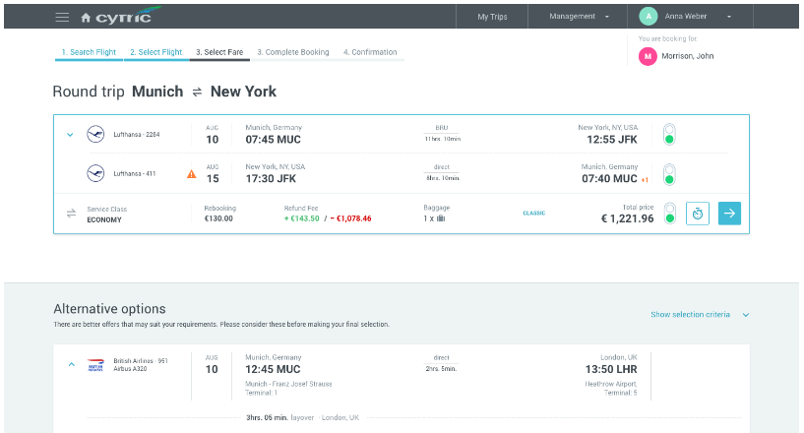
Alternative options page
Cheaper options stand out
Get alternatives
Your trip selection will be used as a basis to find cheaper options
Your selected flight on top
So you can easily compare the selected flight and fare with the alternatives
Intuitive flow
You can always continue keeping your initial trip selection
Notes:
To update the text, just click on the text
More slides with this layout: Copy slide and paste

Slide 22
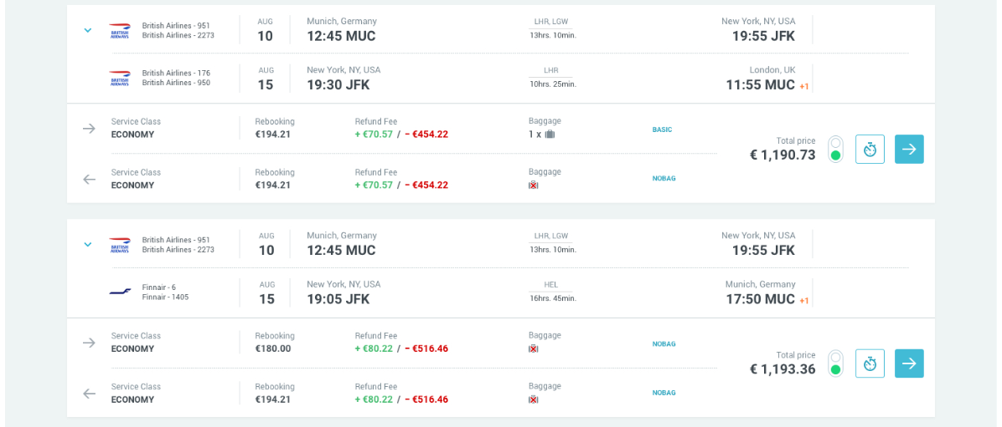
Alternative options page
Save money with cheaper flight options
Clear design
All information clearly displayed for a better customer experience
Less clutter
Expandable section with reason why each option has been identified
More information
Rebooking and cancellation information is shown for each alternative fare
Notes:
To update the text, just click on the text
More slides with this layout: Copy slide and paste

Slide 23
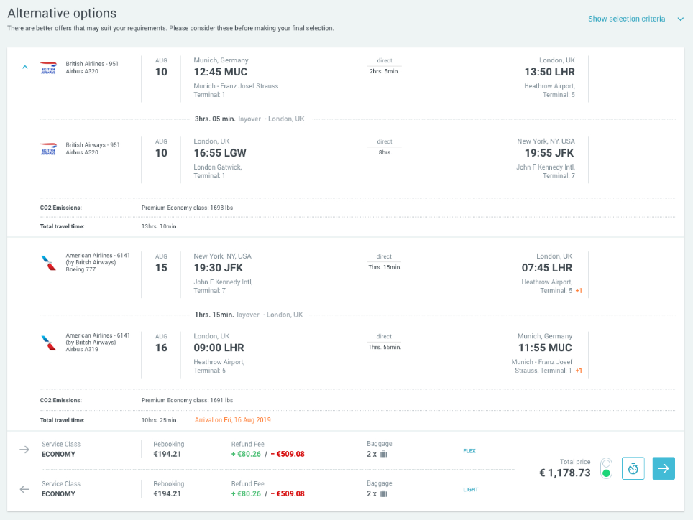
Alternative options page
More information on the alternative options
Clear structure
All information clearly displayed for a better customer experience
More information
Expand it to get more information on any departure or return flight: travel time, layover time and total travel time
Notifications
An orange text is displayed to attract your attention to certain details
Notes:
To update the text, just click on the text
More slides with this layout: Copy slide and paste

Slide 24
Complete Booking Page
(already delivered with 17.9)
Notes:
Divider example with photo
Insert new photo: Click on Insert photo-icon on slide and Insert new photo
Use Crop Tool under Picture Tools to pan and zoom
To update the text, just click on the text
To get more slides with this layout just copy this slide and paste

Slide 25
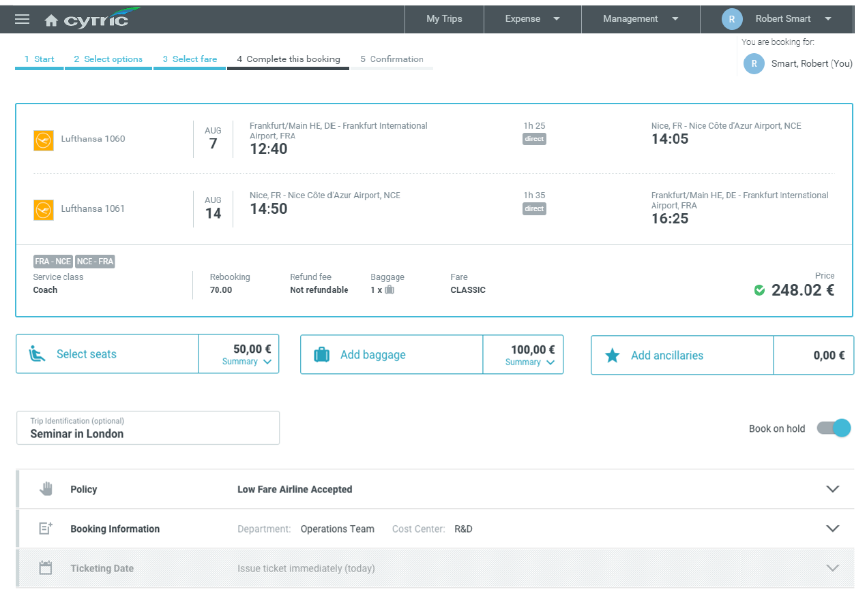
Complete Booking Page for Air
Intuitive summary page
Page includes more
All in one display: itinerary, fare, profile and payment information
Key sections are visible up-front
Comprehensive seat, baggage and ancillary sections
Workflow more user-friendly The booking on-hold option is now displayed on the same page
Notes:
To update the text, just click on the text
More slides with this layout: Copy slide and paste

Slide 26
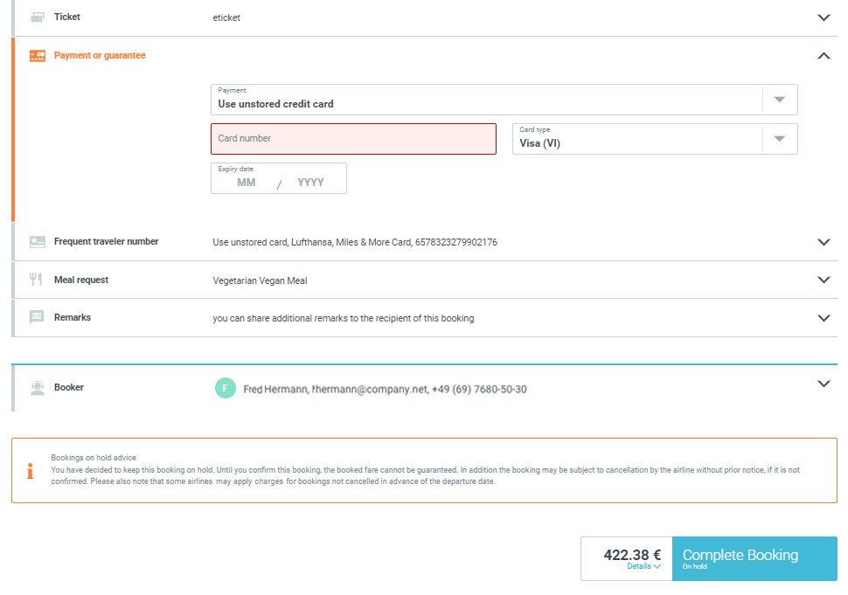
Complete Booking Page for Air
Continuation of same page
Clear structure All information relevant for the booking is presented in expandable sections
Calls to action Sections that require the user's attention (with mandatory data missing) are automatically expanded
Notifications Notifications are displayed at the end of the page before the user continues to complete the booking
Notes:
To update the text, just click on the text
More slides with this layout: Copy slide and paste

Slide 27
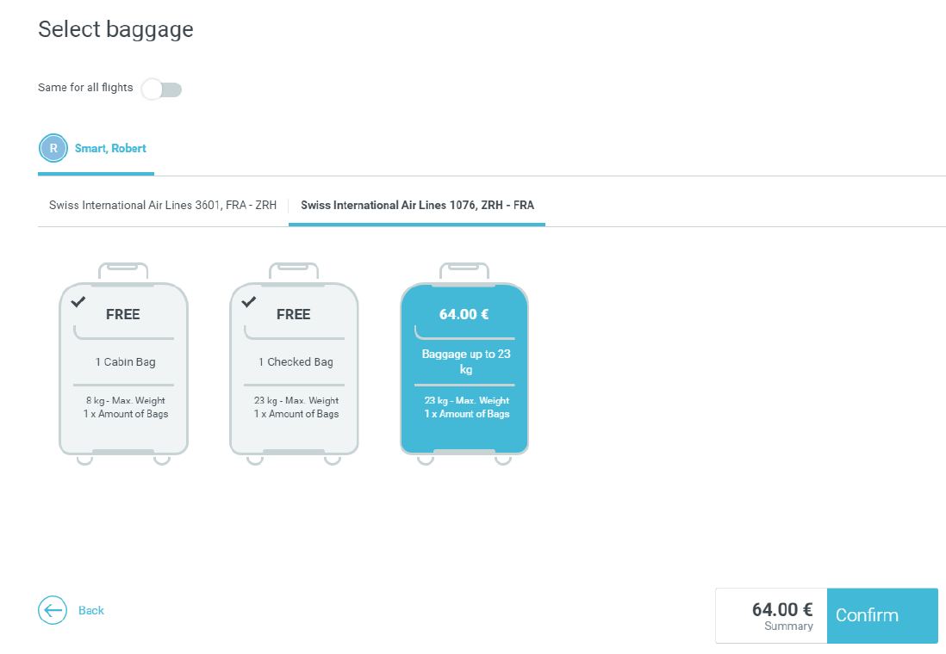
Complete Booking Page for Air
New pop-up window for baggage options
Clear display Intuitive pictures indicate types of baggage and if it is free or chargeable. Selection is highlighted
Clear view
The total amount of the selected baggage stands out
Notes:
To update the text, just click on the text
More slides with this layout: Copy slide and paste

Slide 28
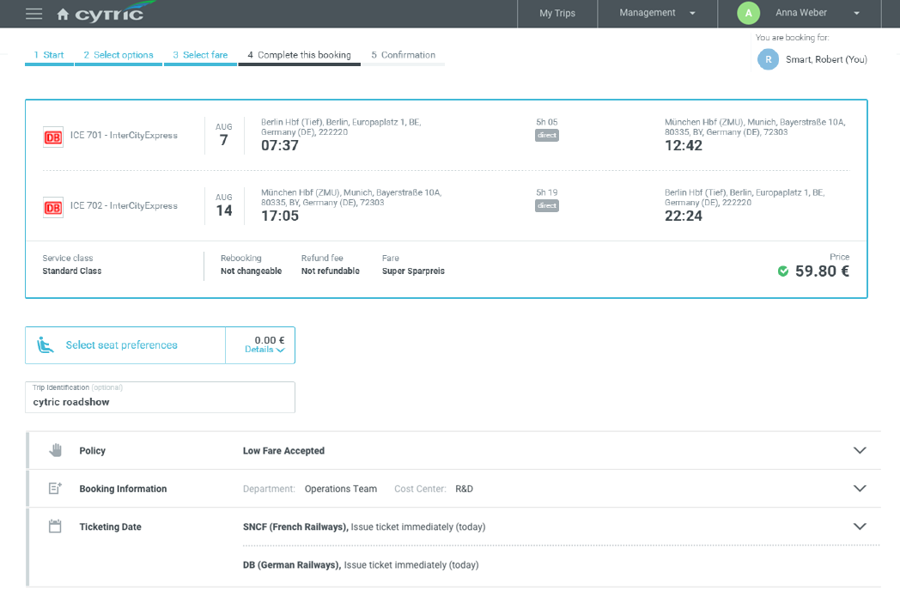
Complete Booking Page for Rail
Intuitive summary page
Page includes more!
All in one display: itinerary, fare, profile and payment information
Same user experience as for Air
Key sections are expandable and visible up-front
Notes:
To update the text, just click on the text
More slides with this layout: Copy slide and paste

Slide 29
Thank you!
For further information, please contact your cytric representative

